Slide 1
Open Source
Md. Zahidul Islam
Assistant Programmer

Slide 2
What is Open Source?
Open source describes a broad general type of software license that makes source code available to the general public with relaxed or non-existent copyright restrictions.

Slide 3
What is Open Source?
So what does that mean?
“…software that is collectively developed by a community of technologists with an interest in a particular application or tool and then distributed at no cost to the broader community of individuals who can find a use for it…”
From open stacks to open source Joe Lucia, Villanova University, February 5, 2008 http://pln.palinet.org/wiki/index.php/From_open_stacks_to_open_source

Slide 4
What is Open Source? Really?
Free to use
Free to change
Free to distribute
An alternative to commercial software
More info at:

Slide 5
Typical OSS development model
Improvements (as source code) and evaluation results: User as Developer
Developer
Development
Community
Trusted Developer
Bug Reports
Trusted Repository
Source Code →
Distributor
“Stone soup development”
User
OSS users typically use software without paying licensing fees
OSS users typically pay for training & support (competed)
OSS users are responsible for paying/developing new improvements & any evaluations that they need; often cooperate with others to do so
Goal: Active development community (like a consortium)

Slide 6
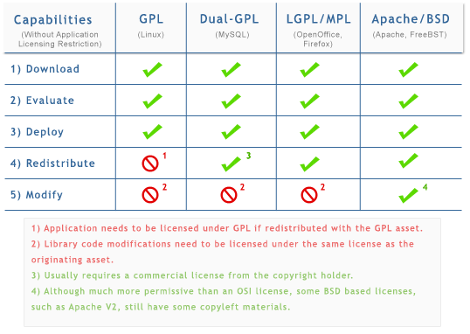
Open Source License

Slide 7
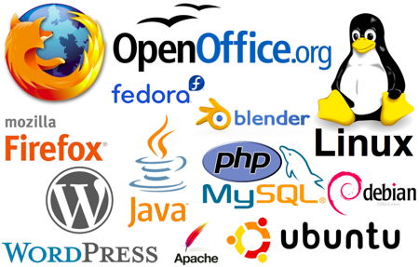
Open source project

Slide 8
Problems with hiding source & vulnerability secrecy
Hiding source doesn’t halt attacks
Presumes you can keep source secret
Attackers may extract or legitimately get it
Dynamic attacks don’t need source or binary
Observing output from inputs sufficient for attack
Static attacks can use pattern-matches against binaries
Source can be regenerated by disassemblers & decompilers sufficiently to search for vulnerabilities
“Security by Obscurity” widely denigrated
Hiding source slows vulnerability response
Vulnerability secrecy doesn’t halt attacks
Vulnerabilities are a time bomb and are likely to be rediscovered by attackers
Brief secrecy works (10-30 days), not months/years

Slide 9
Can “security by obscurity” be a basis for security?
“Security by Obscurity” can work, but iff:
Keeping secret actually improves security
You can keep the critical information a secret
For obscurity itself to give significant security:
Keep source secret from all but a few people. Never sell or reveal source to many. E.G.: Classify
Keep binary secret; never sell binary to outsiders
Use software protection mechanisms (goo, etc.)
Remove software binary before exporting system
Do not allow inputs/outputs of program to be accessible by others – no Internet/web access
Incompatible with off-the-shelf development approaches
Fine for (custom) classified software, but that’s costly
Proprietary software can be secure – but not this way

Slide 10
Why would governments use or create OSS (value for government)?
Can evaluate in detail, lowering risk
Can see if meets needs (security, etc.)
Mass peer review typically greatly increases quality/security
Aids longevity of records, government transparency
Can copy repeatedly at no additional charge (lower TCO)
Support may have per-use charges (compete-able)
Can share development costs with other users
Can modify for special needs & to counter attacks
Even if you’re the only one who needs the modification
Control own destiny: Freedom from vendor lock-in, vendor abandonment, conflicting vendor goals, etc.
In many cases, OSS approaches have the potential to increase functionality, quality, and flexibility, while lowering cost and development time

Slide 11
Why would contractors use/develop OSS for supply to others?
Same list as previous, plus...
OSS use—similar advantages to use of proprietary commercial item
Competitive advantage (if uses & others don’t), because shared development of item across many users (cost, time, quality, innovation) tends to produce better results
Can focus on problem not lower-level issues (if everyone uses)
But with a twist: Avoids risks of depending on proprietary commercial items
Proprietary third-party: Vendor lock-in risks (costs, abandon,...)
A contractor: All other contractors will avoid (to avoid the risk of complete dependence on a direct competitor), inhibiting sharing
OSS development: First-mover advantage
First one to release defines architecture & has best expertise in the OSS component, leading to competitive advantage

Slide 12
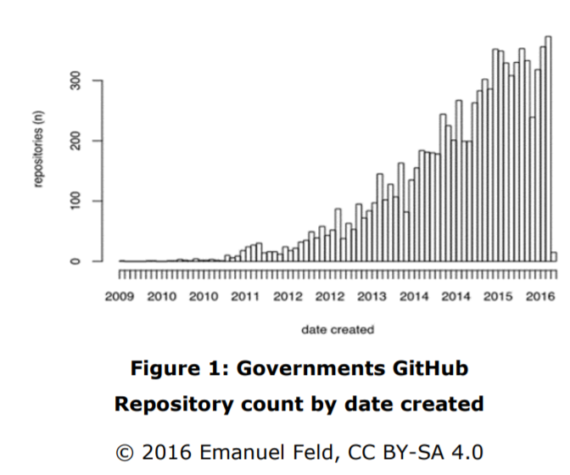

Slide 13
Open source around the world government
https://code4health.org/
https://digitalindia.gov.in
https://code.nasa.gov/
https://code.nsa.gov/
https://github.com/nationalsecurityagency

Slide 14

Questions?

